Slide 1
ANOMALY DETECTION
Team 7
Lalit Jain
Lipsa Panda
Sameer Goel

Slide 2
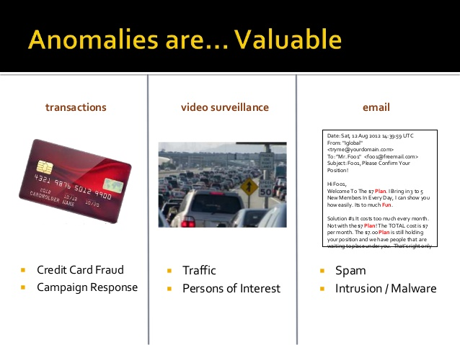
WHAT IS ANOMALY
Data Points that deviates from what is standard ,normal or expected or do not conform an expected pattern.

Slide 3
Is it not just Classification?
The answer is yes if the following three conditions are met.
You have labeled training data
Anomalous and normal classes are balanced ( say at least 1:5)
Data is not auto correlated. ( That one data point does not depend on earlier data points. This often breaks in time series data).

Slide 4

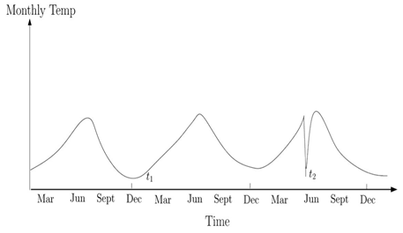
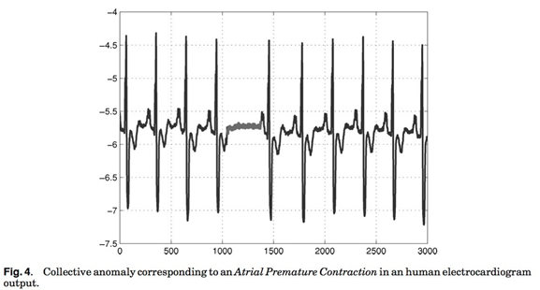
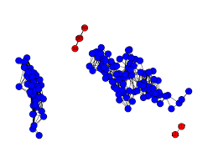




Types OF ANOMALIES
Anomalies can be classified as Point , Collective or Contextual .
Point Anomaly
If an individual data instance can be considered as anomalous with respect to the rest of the data (e.g. purchase with large transaction value)
Contextual Anomaly
If a data instance is anomalous in a specific context, but not otherwise ( anomaly if occur at certain time or certain region. e.g. large spike at middle of night)
Collective Anomaly
If a collection of related data instances is anomalous with respect to the entire data set, but not individual values (e.g. breaking rhythm in ECG)

Slide 5

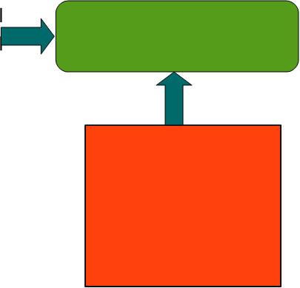
ANOMALY DETECTION TECHNIQUE
Problem Characteristics
Application Domains
Intrusion Detection
Fraud Detection
Traffic Analysis
Nature of Data
Anomaly Detection Technique
Labels
Anomaly Type
Research Areas: Machine Learning Data
Mining Statistics Information Theory Spectral Theory
Output

Slide 6
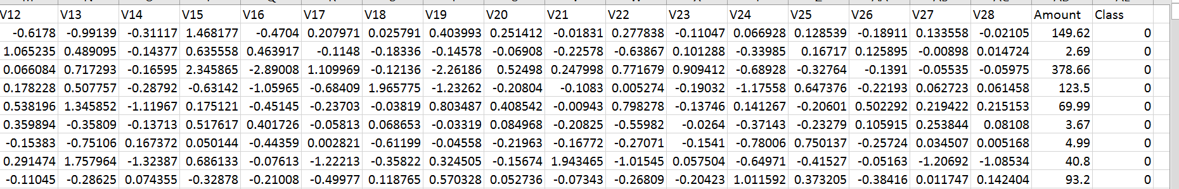
CREDIT CARD Fraud Detection - (Point Anomaly)
Our datasets contains transactions made by credit cards in September 2013 by European cardholders, where there are 492 frauds out of 284,807 transactions.
Note: Dataset was provided us already pre processed and PCA transformed due to confidentiality issues.
Target Variable: Class
0 → Normal Transactions (Non-Fraud)
1 → Fraud Transactions (Fraud)

Slide 7
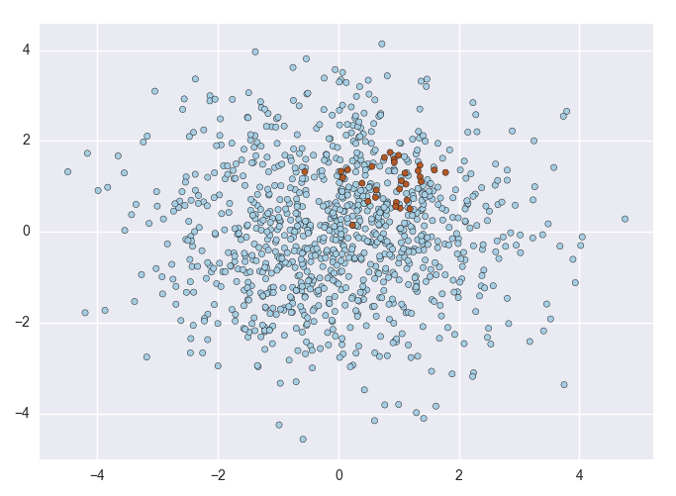

Imbalanced DataseT
The data is highly skewed, the positive class (frauds) account for only 0.172% of all transactions.

Slide 8
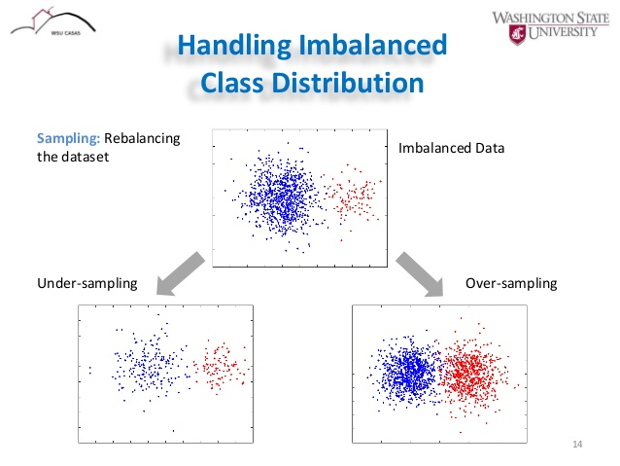
HANDLING IMBALNCE DATA
1) Data sampling:
In which the training instances are modified in such a way to produce a more or less balanced class distribution that allow classifiers to perform in a similar manner to standard classification. Oversample the minority class, Undersample the majority class, Synthesize new minority classes.
E.g. SMOTE, ROSE, EasyEnsemble, BalanceCascade, etc

Slide 9
Other Method’s
2) Algorithmic modification: This procedure is oriented towards the adaptation of base learning methods to be more attuned to class imbalance issues
3) Cost-sensitive learning: This type of solutions incorporate approaches at the data level, at the algorithmic level, or at both levels combined, considering higher costs for the misclassification of examples of the positive class with respect to the negative class, and therefore, trying to minimize higher cost errors
E.g. CostSensitiveClassifier.

Slide 10
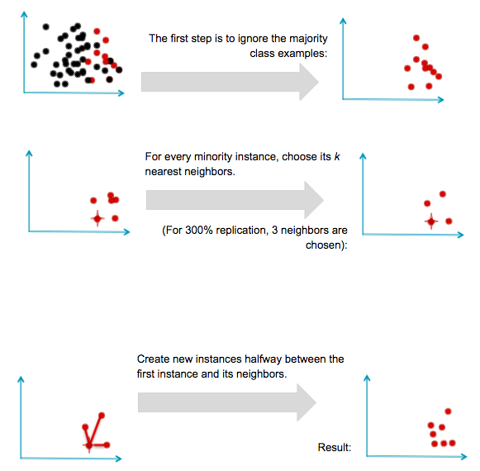
SMOTE
Synthetic Minority Over-sampling Technique
Generating artificial anomalies
New rare class examples are generated inside the regions of existing rare class examples
Artificial anomalies are generated around the edges of the sparsely populated data regions Classify synthetic outliers vs. real normal data using active learning

Slide 11
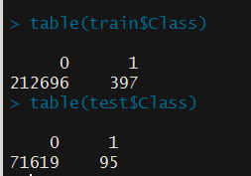
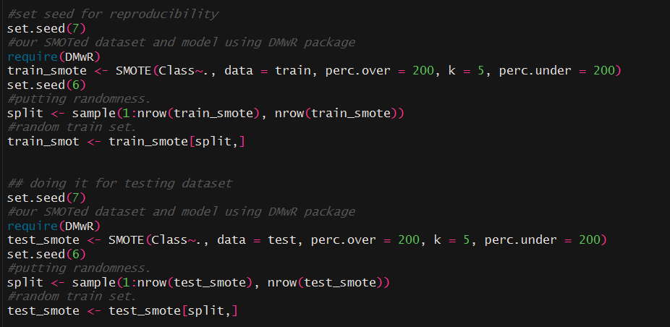
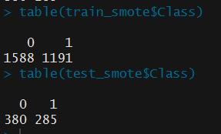
Applying SMOtE to Datatset

Slide 12
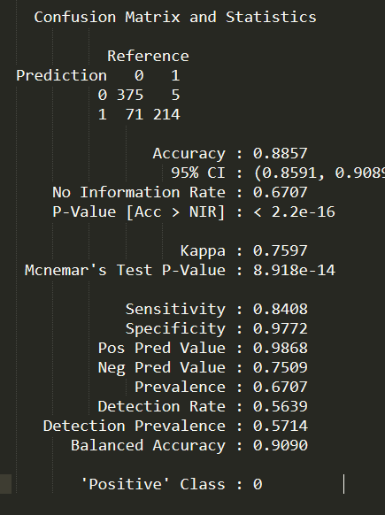
Model Output – Random Forest
Looks highly accurate model with model accuracy of ~89%.
However for Anomaly Detection, we should consider following metrics
The Area Under the ROC curve (AUC) is a good general statistic. It is equal to the probability that a random positive example will be ranked above a random negative example.
The F1 Score is the harmonic mean of precision and recall. It is commonly used in text processing when an aggregate measure is sought.
Cohen’s Kappa is an evaluation statistic that takes into account how much agreement would be expected by chance.

Slide 13
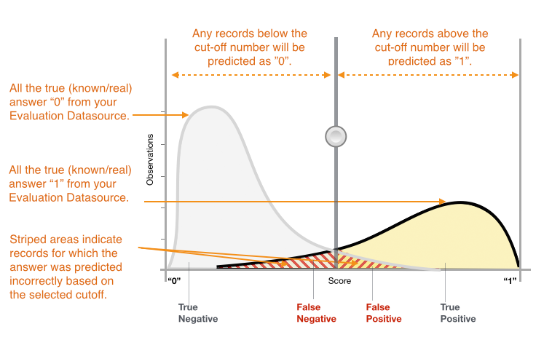
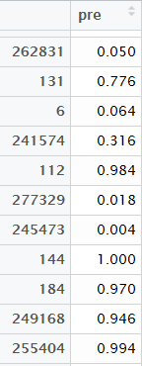
Threshold Confusion ?

Slide 14
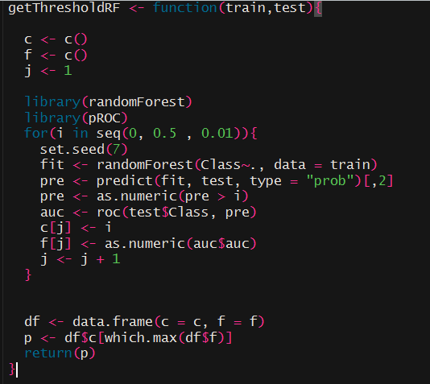
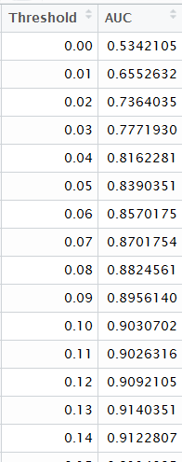
Threshold Calibration
Changing the threshold from a range of 0 to 0.5 and checking the AUC.

Slide 15
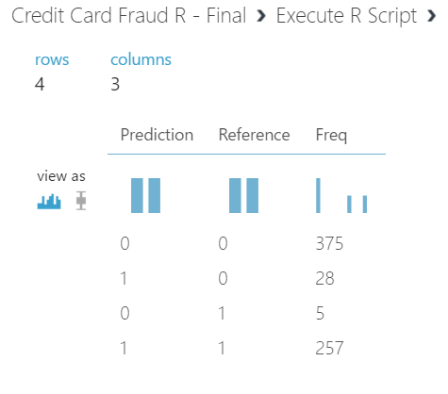
Model Output – AFTER SMOTE AND Calibration
1 → Fraud Transactions
0 → Non-Fraud Transactions
We were able to predict 98% credit card fraud at the same time maintaining a high precision and recall.

Slide 16
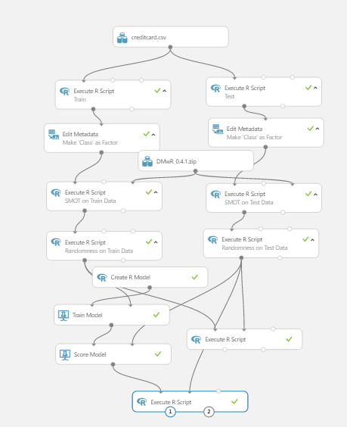
Azure Implementation – RF (SMOTE)

Slide 17
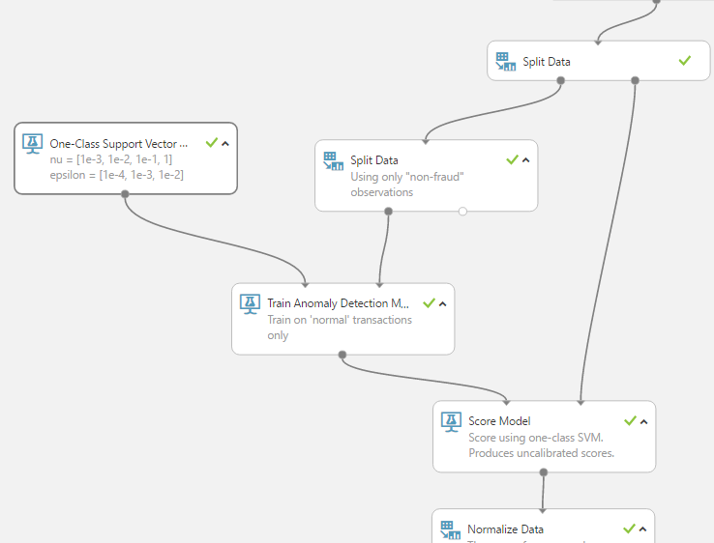
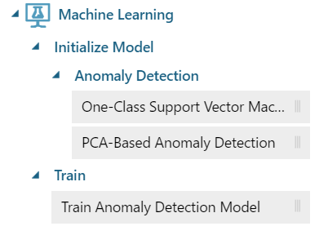
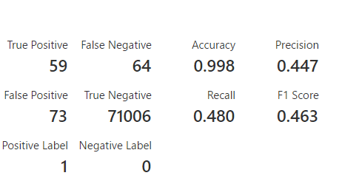
One-Class SVM

Slide 18
Azure Implementation – Using One-Class SVM

Slide 19
Demo
Live Credit Card Fraud Detection – (SMOTE)
Single Transaction – (One Class SVM)
Batch Execution

Slide 20
ReferenceS
(G.E.A.P.A. Batista, R.C. Prati, M.C. Monard, A study of the behaviour of several methods for balancing machine learning training data, SIGKDD Explorations 6 (1) (2004) 20–29. doi: 10.1145/1007730.1007735, N.V. Chawla, K.W. Bowyer, L.O. Hall, W.P. Kegelmeyer, SMOTE: synthetic minority over-sampling technique, Journal of Artificial Intelligent Research 16 (2002) 321–357. doi: 10.1613/jair.953).
(B. Zadrozny, C. Elkan, Learning and making decisions when costs and probabilities are both unknown, in: Proceedings of the 7th International Conference on Knowledge Discovery and Data Mining (KDD’01), 2001, pp. 204–213.).
(P. Domingos, Metacost: a general method for making classifiers cost–sensitive, in: Proceedings of the 5th International Conference on Knowledge Discovery and Data Mining (KDD’99), 1999, pp. 155–164., B. Zadrozny, J. Langford, N. Abe, Cost–sensitive learning by cost–proportionate example weighting, in: Proceedings of the 3rd IEEE International Conference on Data Mining (ICDM’03), 2003, pp. 435–442.)
https://www.analyticsvidhya.com/blog/2016/03/practical-guide-deal-imbalanced-classification-problems/

Slide 22
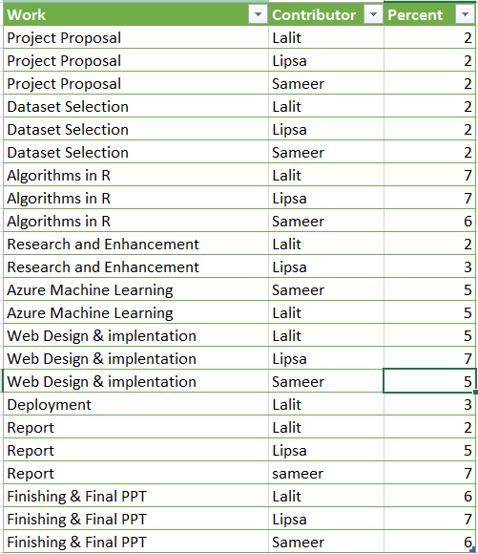
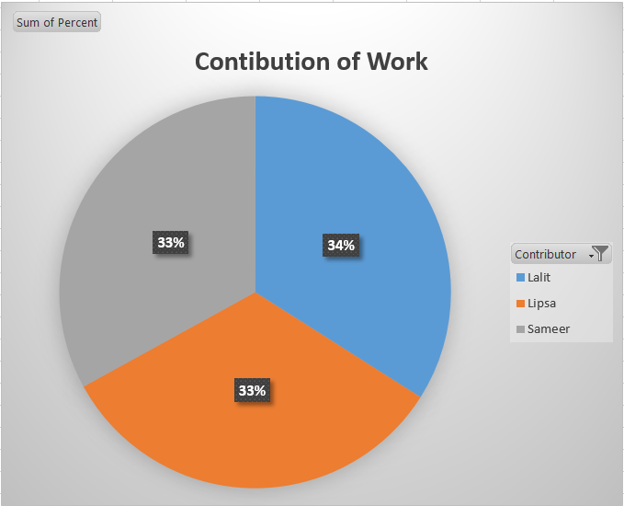
Team Contribution

